Slide 1
Global Trends and Opportunities
in Patent Protection
David K. Ho, Ph.D., J.D.

Slide 2
(A) Global Trends
1. WIPO (World Intellectual Property Organization)
Patent Cooperation Treaty (PCT)
File one PCT application at a receiving office
Then file multiple national phase applications later
PCT Time Line
0 Month: First Application
12th Month: PCT Application
18th Month: Publication
30th Month: National Phase Application

Slide 3
(A) Global Trends
2. Current Trends of PCT Applications
PCT Applications Grow by 7.3%
About 233,000 PCT applications were filed in 2016, representing an increase of 7.3% on 2015.
Countries:
USA 56,595 (24.3%)
Japan 45,239 (19.4%)
China 43,168 (18.5%)
Germany 18,315 (7.9%)
Korea 15,560 (6.7%)

Slide 4
(A) Global Trends
3. Current Trends of PCT Applications
Business Applicants:
ZTE (China) 4,123
Huawei (China) 3,692
Qualcomm (USA) 2,466
Mitsubishi (Japan) 2,053
LG (Korea) 1,888
Hewlett Packard (USA) 1,742
Intel (USA) 1,692
BOE Technology (China) 1,672

Slide 5
(A) Global Trends
4. Current Trends of PCT Applications
University Applicants:
California (USA) 434
MIT (USA) 236
Harvard (USA) 162
Johns Hopkins (USA) 158
Texas (USA) 152
Seoul (Korea) 122
Tokyo (Japan) 108
Stanford (USA) 104
Hanyang (Korea) 101

Slide 6
(A) Global Trends
5. Current Trends of PCT Applications
Technological Fields:
Digital communication 17,776
Computer technology 17,551
Electrical machinery, apparatus, energy 14,468
Medical technology 14,256
Measurement instrument 9,338
Transportation 8,716
Pharmaceuticals 8,216
Audio-visual technology 7,069

Slide 7
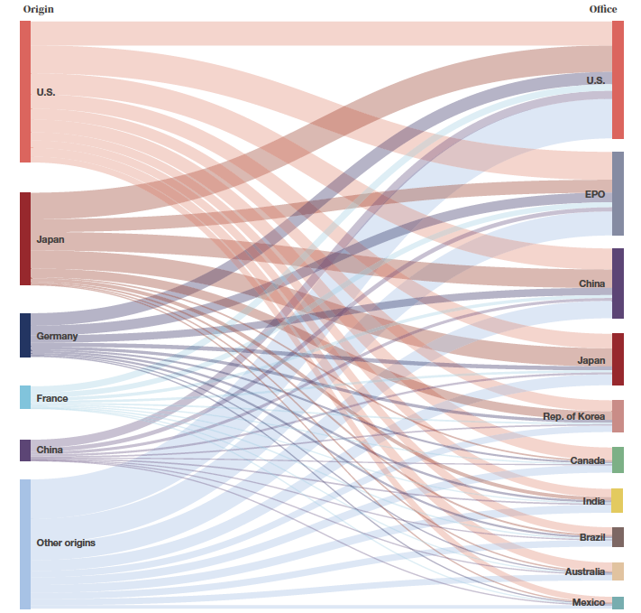
(A) Global Trends
6. Top 5 National Phase Countries

Slide 9
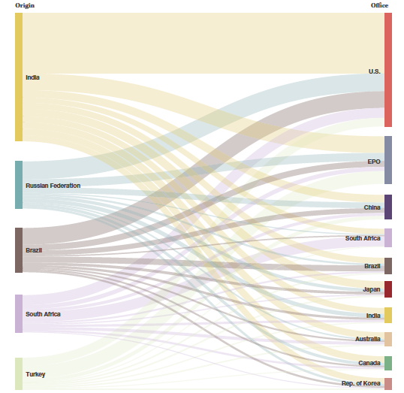
(A) Global Trends
7. Top 5 National Phase from Middle Income Countries

Slide 11
(A) Global Trends
8. Current Trends of USA Patents Granted (2015)
Countries:
U.S.A. 148,068
Japan 52,730
South Korean 18,261
Germany 15,156
Taiwan 11,568
China 7,105
France 6,476
Canada 4,915
United Kingdom 4,033
Netherlands 3,476

Slide 12
(A) Global Trends
9. Current Trends of USA Patents Granted (2015)
Assignees:
Individually owned 18,899
IBM (USA) 7,309
Samsung (Korea) 5,059
Canon (Japan) 4,127
Qualcomm (USA) 2,900
Google (USA) 2,835
Toshiba (Japan) 2,582
Sony (Japan) 2,448
LG (Korea) 2,241
Apple (USA) 1,937

Slide 13
(A) Global Trends
10. Current Trends of USA Patents Granted (2015)
Chinese Assignees:
Huawei Technologies (Shenzhen) 795
Shenzhen China Star 496
ZTE (Shenzhen) 416
BOE Technology (Beijing) 275
Hong Fu Jin Precision (Shenzhen) 208
Individually owned 355
Tsinghua University (Beijing) 184
Huawei Device (Shenzhen) 128
Tencent (Shenzhen) 127
Fu Tai Hua Industry (Shenzhen) 116

Slide 14
(A) Global Trends
11. Current Trends of USA Patents Granted (2015)
Taiwanese Assignees:
Taiwan Semi Conductor 1,757
Individually owned 1,025
Hon Hai Precision 573
Industrial Technology Res. Inst. 422
Wistron 369
Au Optronics 308
United Microelectronics 252
HTC 248
Mediatek 247
Macronix 231

Slide 15
(A) Global Trends
12. Current Trends of USA Patents Granted (2015)
Indian Assignees:
Individually owned 101
Council of Sci. & Ind. Res. 99
Tata Consultancy Service 90
Infosys Limited 72
Wipro Limited 25
Lupin Limited 21
Wockhardt 18
Cadila Healthcare 15
Dr. Reddy’s Lab 13
Hetero Research Foundation 12

Slide 16
(A) Global Trends
13. Current Trends of USA Patents Granted (2015)
Technological Fields:
Drug, Bio-Affecting Compositions 12,693
Active Solid State Devices 11,996
Multiplex Communications 11,004
Telecommunication 7,884
Computers Graphics & Systems 7,632
Multicomputer Data Transfer 6,347
Television 6,053
Data Processing: Database & File MGMT 5,500
Data Processing: Vehicles & Navigation 5,309
Semiconductor Device Manufacturing 4,965

Slide 17
(A) Global Trends
14. Current Trends of USA Patents Granted (2015)
Technological Fields from Chinese Assignees:
Multiplex Communications 808
Active Solid State Devices 404
Telecommunication 381
Liquid Crystal Cells 317
Computers Graphics & Systems 272
Pulse or Digital Communications 219
Drug, Bio-Affecting Compositions 218
Multicomputer Data Transferring 192
Electrical Systems & Devices 188
Semiconductor Device Manufacturing 174

Slide 18
(A) Global Trends
15. Current Trends of USA Patents Granted (2015)
Technological Fields from Taiwanese Assignees:
Active Solid State Devices 1,630
Computers Graphics & Systems 718
Semiconductor Device Manufacturing 709
Electrical Systems & Devices 440
Illumination 350
Electrical Connectors 311
Television 287
Static Information Storage 238
Telecommunication 233
Optical Systems 202

Slide 19
(A) Global Trends
16. Current Trends of USA Patents Granted (2015)
Technological Fields from Indian Assignees:
Data Processing: Database & File MGMT 258
Multiplex Communication 228
Multicomputer Data Transferring 207
Drugs, Bio-Affecting Compositions 195
Organic Compounds 175
Error Detection & Correction 133
Data Processing: Software Development 128
Information Security 124
Telecommunication 112
Image Analysis 105

Slide 20
(B) Global Opportunities
1. Current Opportunities
Our Decision:
We can choose to admire the above trends and just say, “Wow!”
We can turn these trends into our opportunities!
We are reminded to find “Smart Solutions”
Source of Inventions:
Companies: large, mid-size, and start-up
Universities
Research Institutes
Individuals

Slide 21
(B) Global Opportunities
2. Current Opportunities
Flow of Applications:
Within same country: USA, China, India, Taiwan, etc.
Within same region: Asia, North America, Europe, etc.
Worldwide:

Slide 22
(B) Global Opportunities
3. Current Opportunities
Applicant’s Perspective:
Patent protection is a costly and lengthy process
Before filing a patent application in COUNTRY A:
What is the market potential?
Who are the technological competitors?
Can this technology be sold?
Is it possible to license this technology?
What is the quality of attorneys?
What is the average cost?
Is there a need for translation?
Is there any legal or procedural issue?

Slide 23
(B) Global Opportunities
4. Current Opportunities
Applicant’s Strategy:
Aim at critical innovation proactively
Understand the risk in advancing a technology
Choose QUALTIY over QUANTITY
Invest in research and development
Build up from the foundation
Support higher education
Encourage creativity
Seek grant and investment support
Search for collaboration

Slide 24
(B) Global Opportunities
5. Current Opportunities
Applicant’s Consideration: Your Attorneys Must Be:
Having a global perspective
Willing to work with inventors enthusiastically and effectively
Overcoming challenges:
Language
Culture
Time zone
Communication style
Low budget firms are OK, but may only provide minimal service
High budget firms are OK, but may only provide expensive invoices

Slide 25
(B) Global Opportunities
6. Current Opportunities
Attorney’s Perspective:
Finding opportunities to offer our legal skills in COUNTRY A
Having a right attitude by:
Serving the needs of the Applicants
Offering meaningful strategies
Providing value-added and cost-effective services
Communicating responsively and in a timely fashion
Abiding by highest ethical standards

Slide 26
(B) Global Opportunities
7. Current Opportunities
Attorney’s Consideration:
Prepare a patent application:
What is the invention?
Particularly pointing out, and distinctly claiming
Describing each component in the claims sufficiently
Avoid submitting a scientific publication
Titles and abstract may not tell what the invention is
Results and discussions may not describe what the claim is
A long list of references creates “weight” but not “substance”

Slide 27
(B) Global Opportunities
8. Current Opportunities
Attorney’s Consideration (Cont’d):
Writing in simple and clear language for:
Examiners
Translators
Including both broad and specific descriptions and claims
Some jurisdiction allows broad interpretation
Some jurisdiction requires specific interpretation
Aim at preparing the application so that it can be filed in either type of jurisdiction

Slide 28
(B) Global Opportunities
9. Current Opportunities
Attorney’s Consideration (Cont’d):
Planning a provisional application as a “non-provisional” application
Treat it like a final application
Changes between provisional application and PCT application may create issues
Do not risk having the “priority document” invalidated
Disclosure in examples, tables, and drawings
Should be written out in full description.

Slide 29
(C) Conclusion
From Global Trends to Global Opportunities
Let Us Learn Together:
The world is such a beautiful and wonderful place
We have become special friends at this conference
As friends, we can learn and work together
Please let me know if I can be of help to you
See you all in Washington, DC!

Slide 30
Thank You!
Harvest IP Law LLP
1455 Pennsylvania Avenue NW, Suite 400
Washington, DC 20004, U.S.A.
www.harvestiplaw.com

